Slide 1
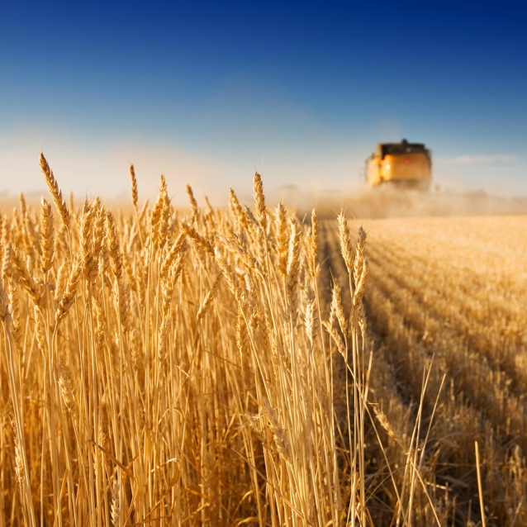


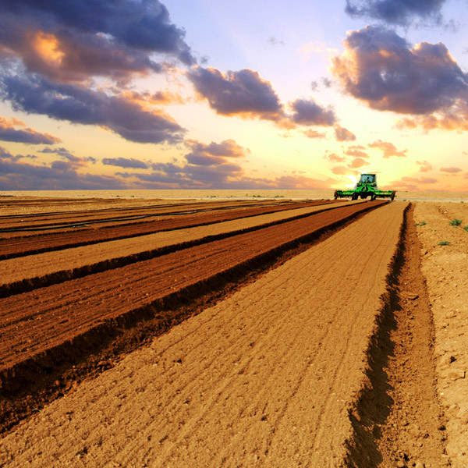
Measuring the effects of Extreme Weather Events on Yields: the Dutch Case
MACSUR, April 9th, 2015
Jeff Powell, LEI, The Netherlands

Slide 2
Paper Objectives
Using panel data and econometric techniques, estimate the effects of extreme weather events on Dutch winter wheat yields while controlling for other inputs.
Deeper motivation: argue that such events are local, estimation requires local data and knowledge.
Obstacle: Temporal mismatch between detailed recent production data (12 years) and longer term weather data (+100 years).
Two papers:
What are the long-term weather trends?
What are the implications of those trends for yields?
2

Slide 3
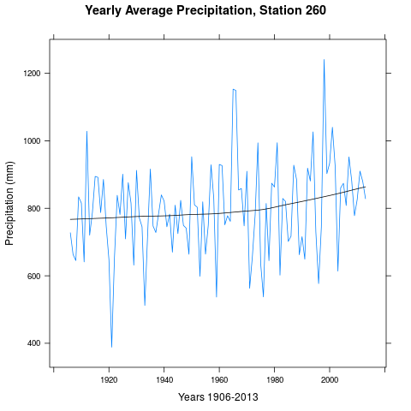
Long term weather Trends
3

Slide 4
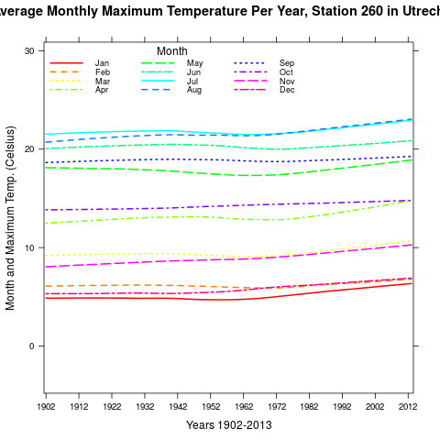
Long term weather Trends
4

Slide 5
Extreme Events
IPCC reports argue that extreme events, e.g., extremely hot or wet short-term periods, are the real danger to yields.
Extremes were defined using several methods:
A quantile method, 95% for a given day.
An absolute scale, above 32 degrees on a given day.
A detail, is an extremely wet day on July 26th the same as an extremely wet day on July 27th? Used daily/weekly/monthly data. A balance between accuracy and tractability.
5

Slide 6
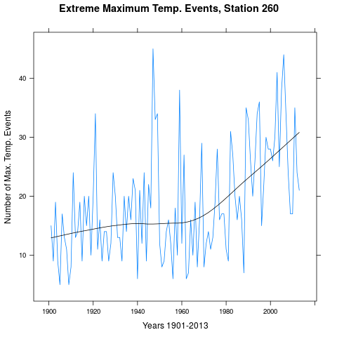
Long term weather Events
6

Slide 7
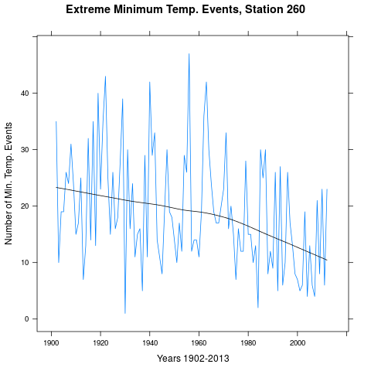
Long term weather Trends
7

Slide 8
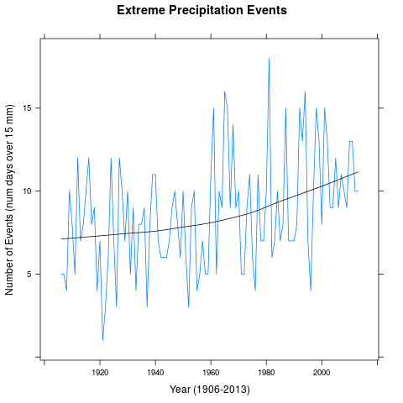
Long term weather Trends
8

Slide 9
Results
Strong statistical support for an increase in the number of high temperature events and precipitation events.
Strong statistical support for a decrease in the number of low temperature events.
ARIMA forecasts suggest that such events will, at least, remain at their current high/low levels.
9

Slide 10
Panel Data
LEI data from 2002-2013. Comprehensive data set at both the farm and crop level.
Detail: electricity, fuel at farm, not crop level)
Weather data from KNMI for around 32 stations throughout the Netherlands.
Combine data, mix, stir and bake.
Econometric Details:
Within or fixed-effects transformation
Time variables not significant as a group
Signs of coefficients as expected.
10

Slide 11
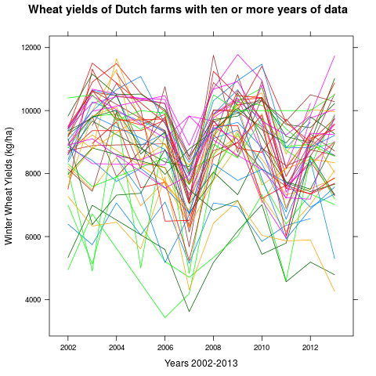
The Panel
11

Slide 12
12

Slide 13
13

Slide 14
Conclusions
More high precipitation and maximum temperature events will reduce yields.
The effects of minimum temperature events depend on the week in which they occur. Fewer low temperature events in certain weeks will increase yields while decreasing yields in other weeks.
Micro-exercise: examine weather effects on a specific crop during specific weeks in its development.
14

